Slide 1

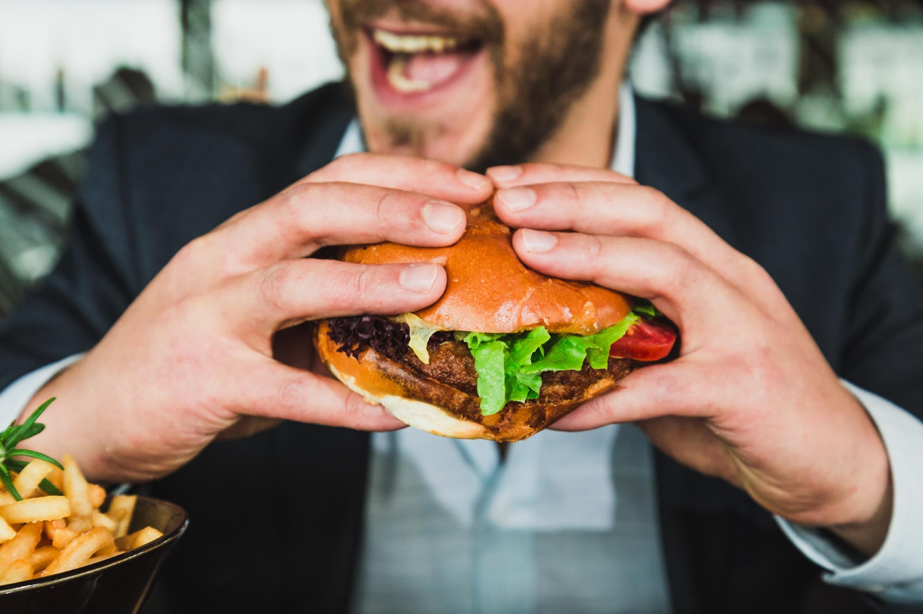

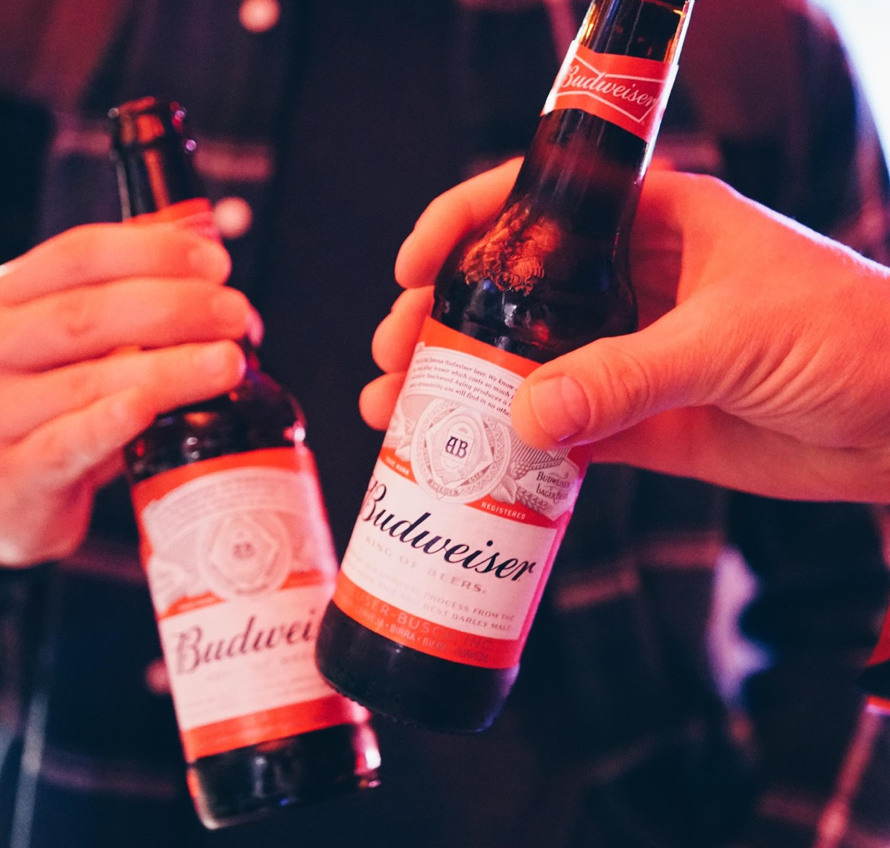
What drives happiness?
Exploring different happiness myths using the World Happiness Report.

Slide 2
What we’ll cover today
Purpose and Methodology
Results and Conclusions
Discussion and Critique
Dataset overview
Questions and purpose
Visualizations
Final decision tree model
Limitations
What advice we would give to future students

Slide 3
Purpose
PURPOSE AND METHODOLOGY • RESULTS AND CONCLUSIONS • DISCUSSION AND CRITIQUE
Our purpose, was to explore what drives happiness across the world, through the lens of four common myths about happiness:
Money can’t buy happiness
Glück ist: keine Termine und leicht einen sitzen
Barriga llena, corazón contento
Happy wife, happy life
Do wealthier countries score higher on the happiness index?
Does this hold for countries with high levels of income inequality?
Do alcohol-drinking countries score higher?
Is it the same for all types of alcohol?
Do countries who have more food score higher?
What kind of food makes people happiest?
Are countries with higher levels of gender equality happier?
Notes:
"True happiness is when are free of appointments and tipsy"

Slide 4

Background and Methodology
PURPOSE AND METHODOLOGY • RESULTS AND CONCLUSIONS • DISCUSSION AND CRITIQUE
Methodology:
Background on the World Happiness Report
1.
Clean WHR dataset and join with Gapminder, Food and Agriculture, Alcohol, Gender Equality datasets.
Explore distribution of happiness across countries and continents.
Investigate our chosen quotes and answering our research questions. Do money, food, alcohol, and gender equality impact happiness?
Building a model to explore what drives happiness and predicting the UK’s happiness score based on our selected factors.
2.
3.
The happiness scores use data from the Gallup World Poll. The scores are based on answers to the main life evaluation question asked in the poll. This question, known as the Cantril Ladder, asks respondents to think of a ladder with the best possible life for them being a 10 and the worst possible life being a 0 and to rate their own current lives on that scale.
4.
Notes:
GDP from gapminder
Gender Inequality from World Bank
Food Supply from Food and Agriculture Org.
Alcohol consumption from FiveThirtyEight

Slide 5
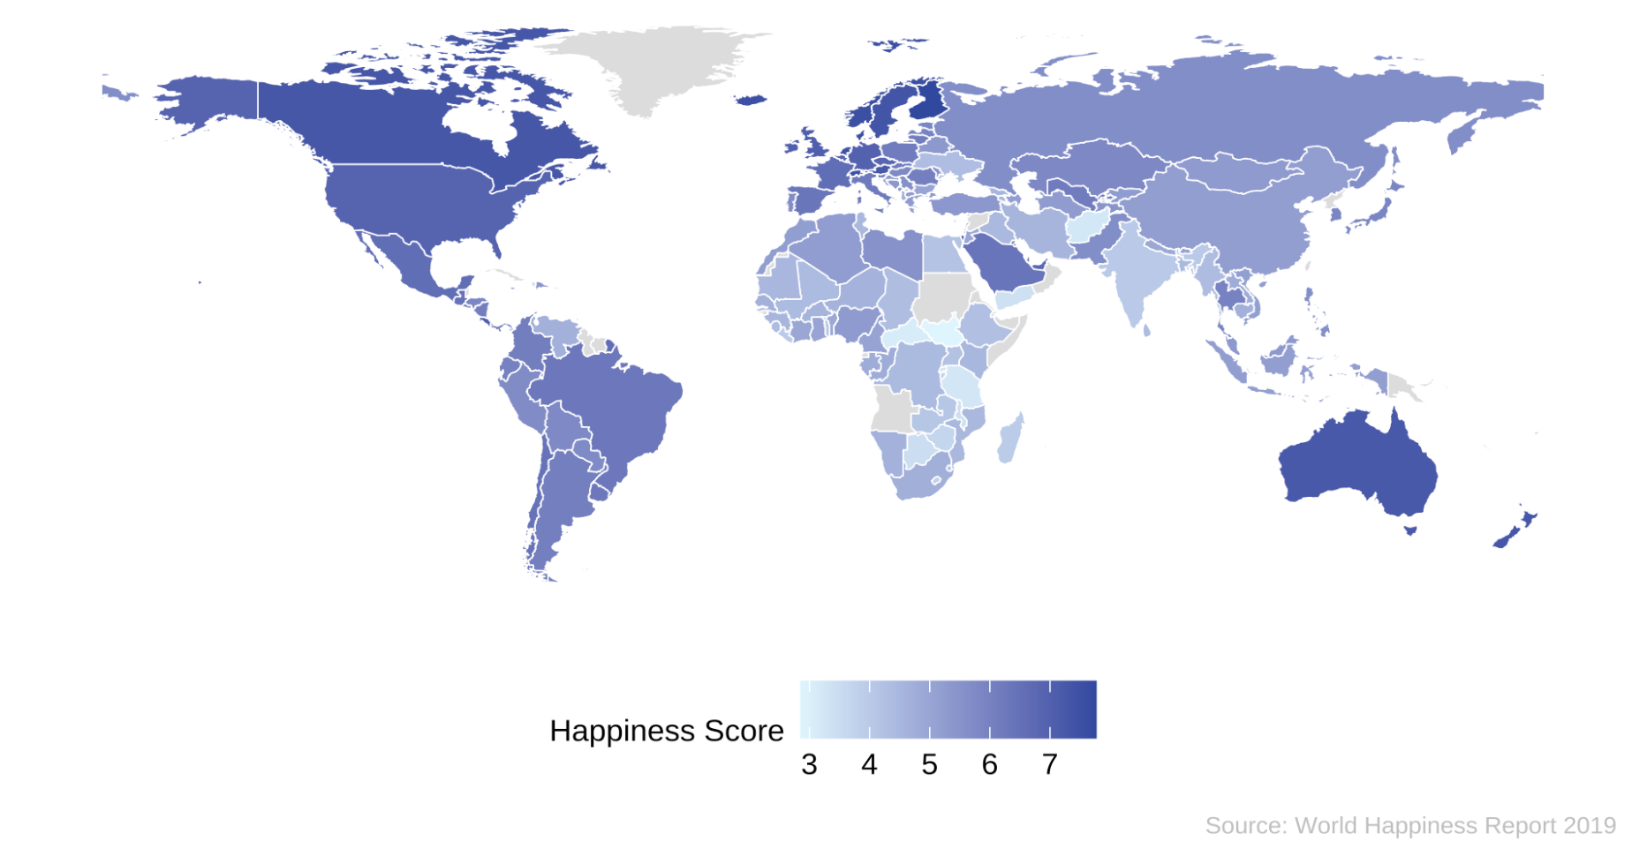
How happy is the world?
PURPOSE AND METHODOLOGY • RESULTS AND CONCLUSIONS • DISCUSSION AND CRITIQUE
Happiness score by country

Slide 6
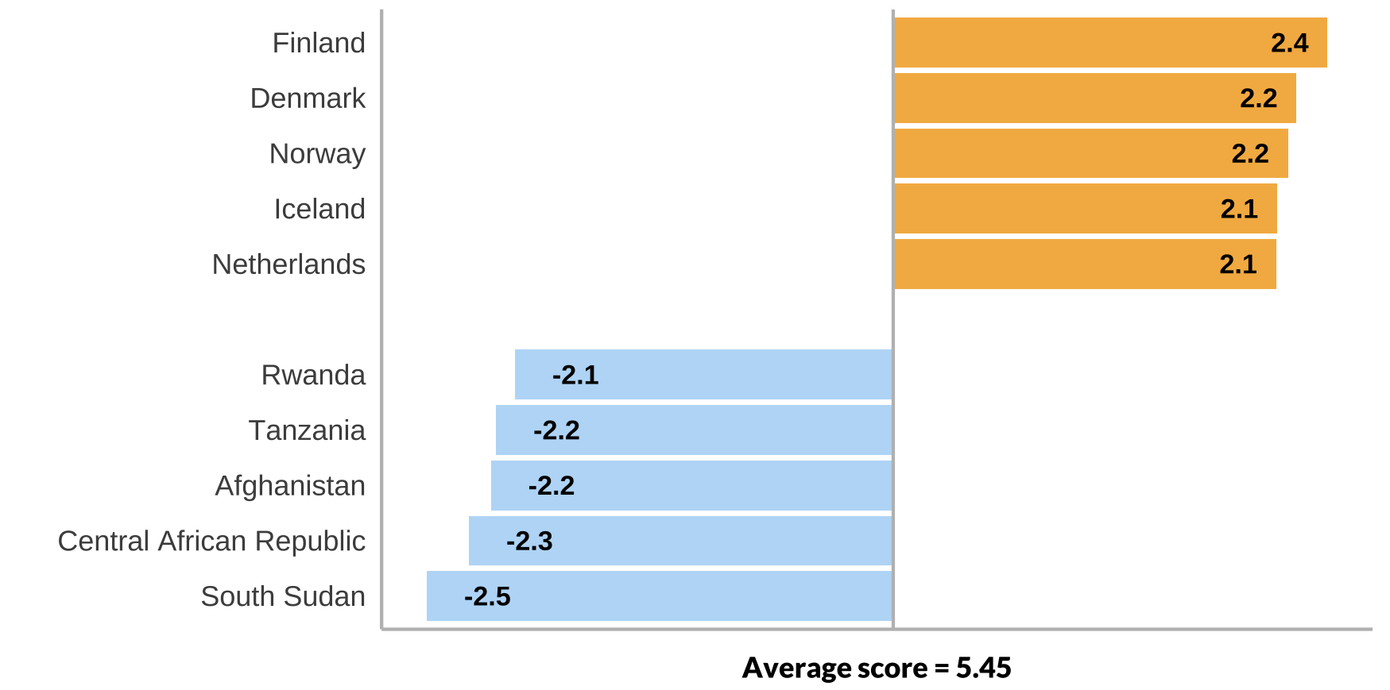
The top countries in terms of happiness are all in Northern Europe
PURPOSE AND METHODOLOGY • RESULTS AND CONCLUSIONS • DISCUSSION AND CRITIQUE
Difference of the top five happiness scores and bottom five happiness scores compared to the average global score

Slide 7
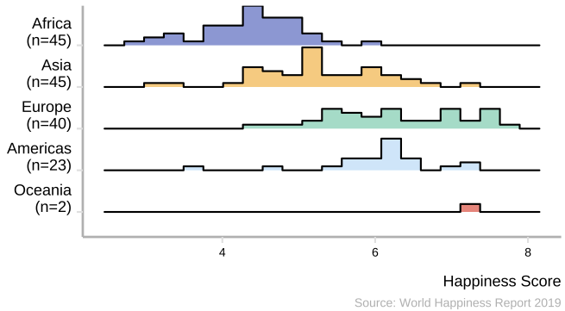
Happiness scores vary strongly across continents
PURPOSE AND METHODOLOGY • RESULTS AND CONCLUSIONS • DISCUSSION AND CRITIQUE
Happiness score distribution per continent
Africa is the most unhappy continent on average
Asia and the Americas have a wide range of happiness scores across countries

Slide 8
Money can’t buy happiness.
Swiss philosopher Jean-Jacques Rousseau

Slide 9
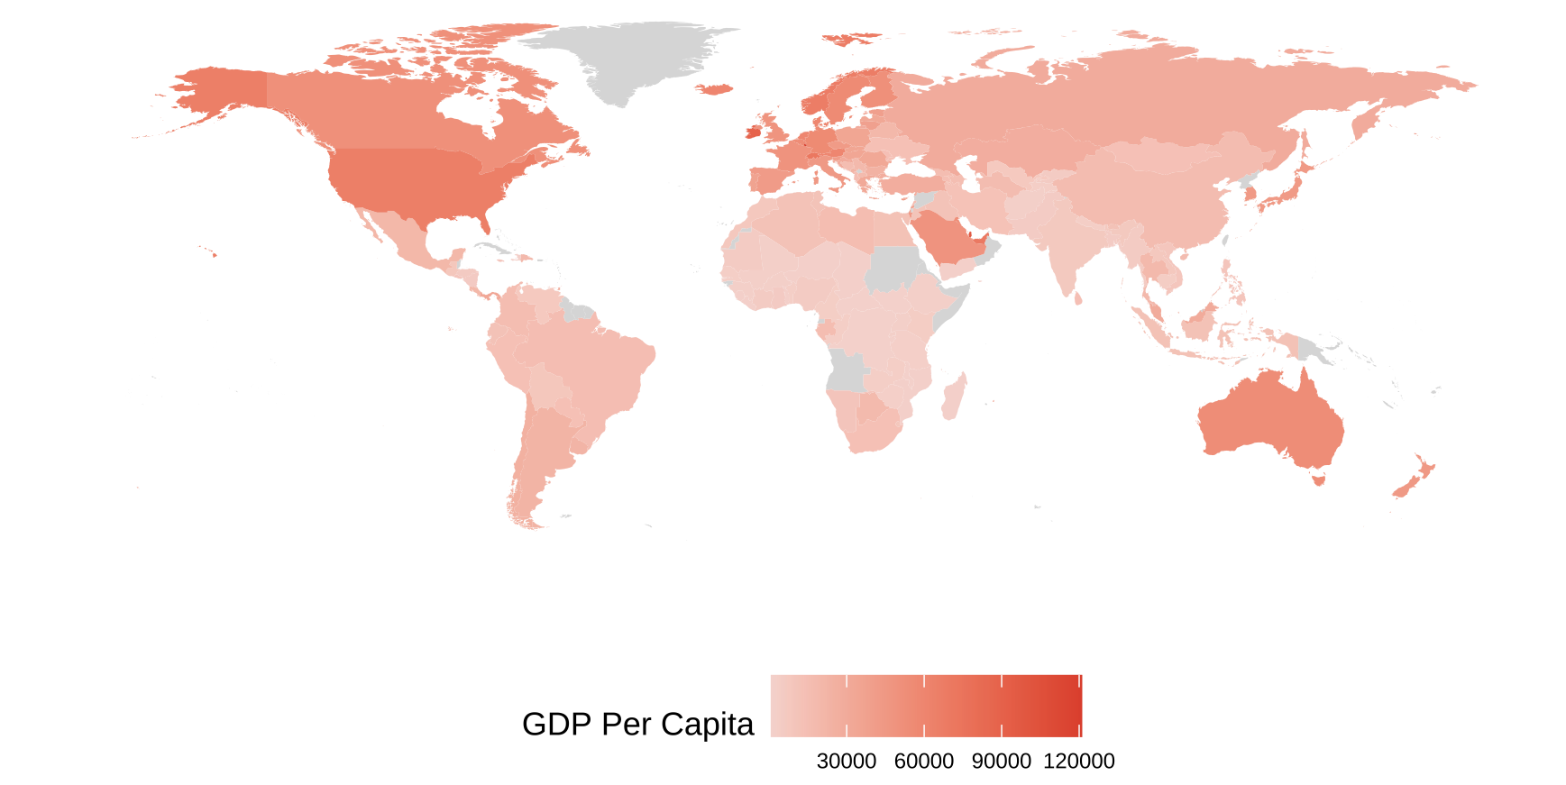
Where are the riches?
PURPOSE AND METHODOLOGY • RESULTS AND CONCLUSIONS • DISCUSSION AND CRITIQUE
Distribution of GDP per capita across the globe
Source: Gapminder

Slide 10
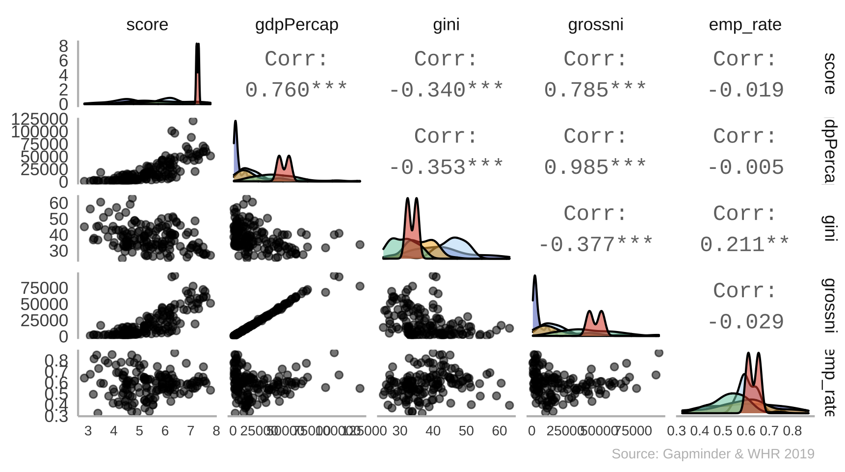
Economic factors are an important foundation to happiness
PURPOSE AND METHODOLOGY • RESULTS AND CONCLUSIONS • DISCUSSION AND CRITIQUE
Correlation between various economic indicators and happiness
Happiness score has very strong correlations with GDP per capita and Gini coefficient.

Slide 11
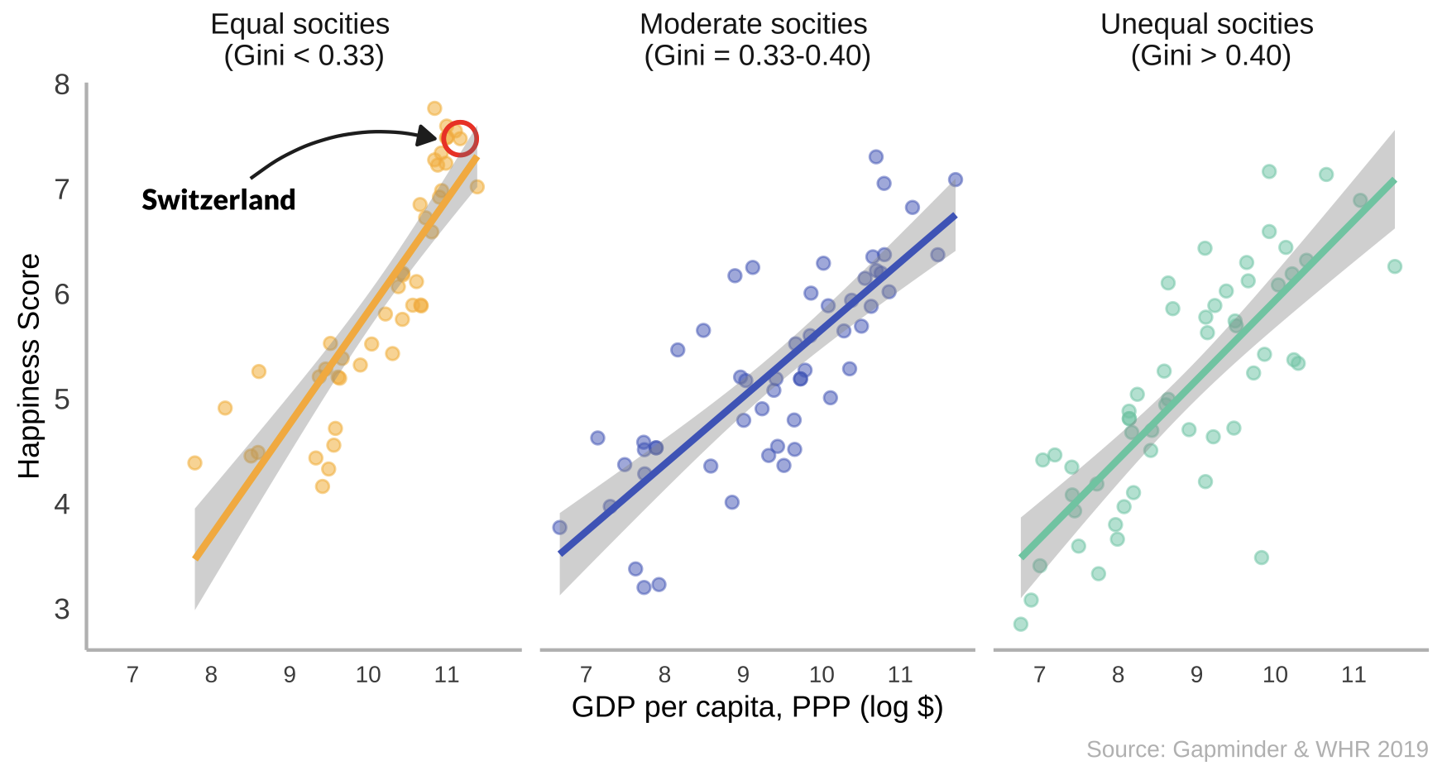
Money buys happiness, regardless of income inequality
PURPOSE AND METHODOLOGY • RESULTS AND CONCLUSIONS • DISCUSSION AND CRITIQUE
Relationship between GDP per capita (PPP) and Happiness Score in different societal structures
There is a positive correlation between income and happiness.
Source: Gapminder

Slide 12
Glück ist: keine Termine und leicht einen sitzen
German saying

Slide 13
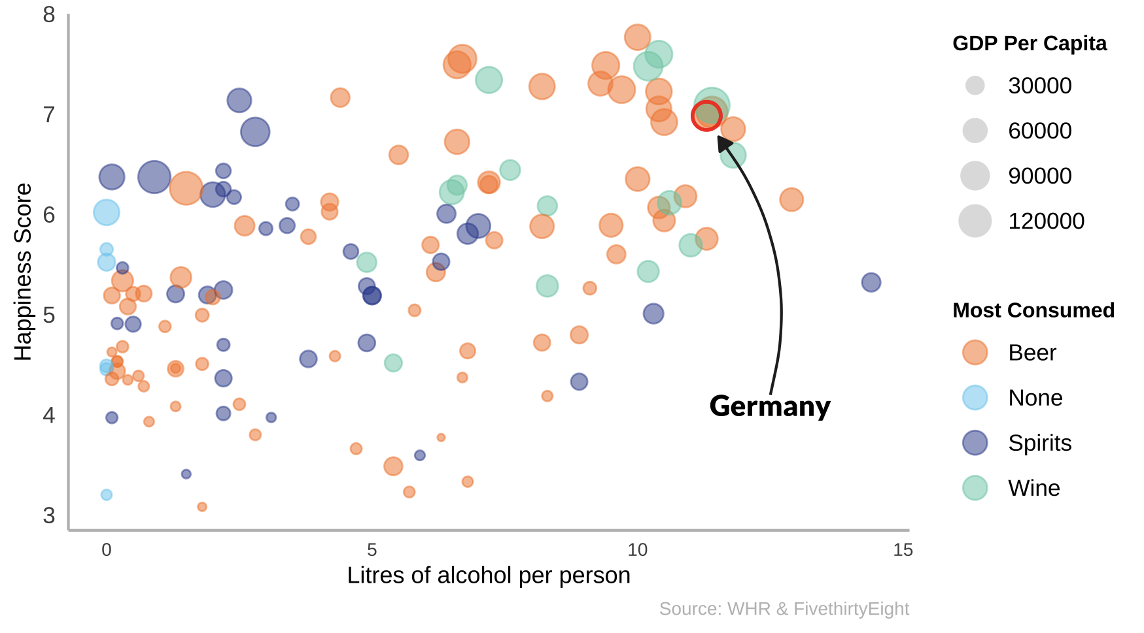
In happier countries, people drink more
PURPOSE AND METHODOLOGY • RESULTS AND CONCLUSIONS • DISCUSSION AND CRITIQUE
Litres of alcohol per person versus happiness score, by most consumed drink and GDP per capita.
Alcohol consuming countries tend to be happier, but they’re also wealthier!

Slide 14
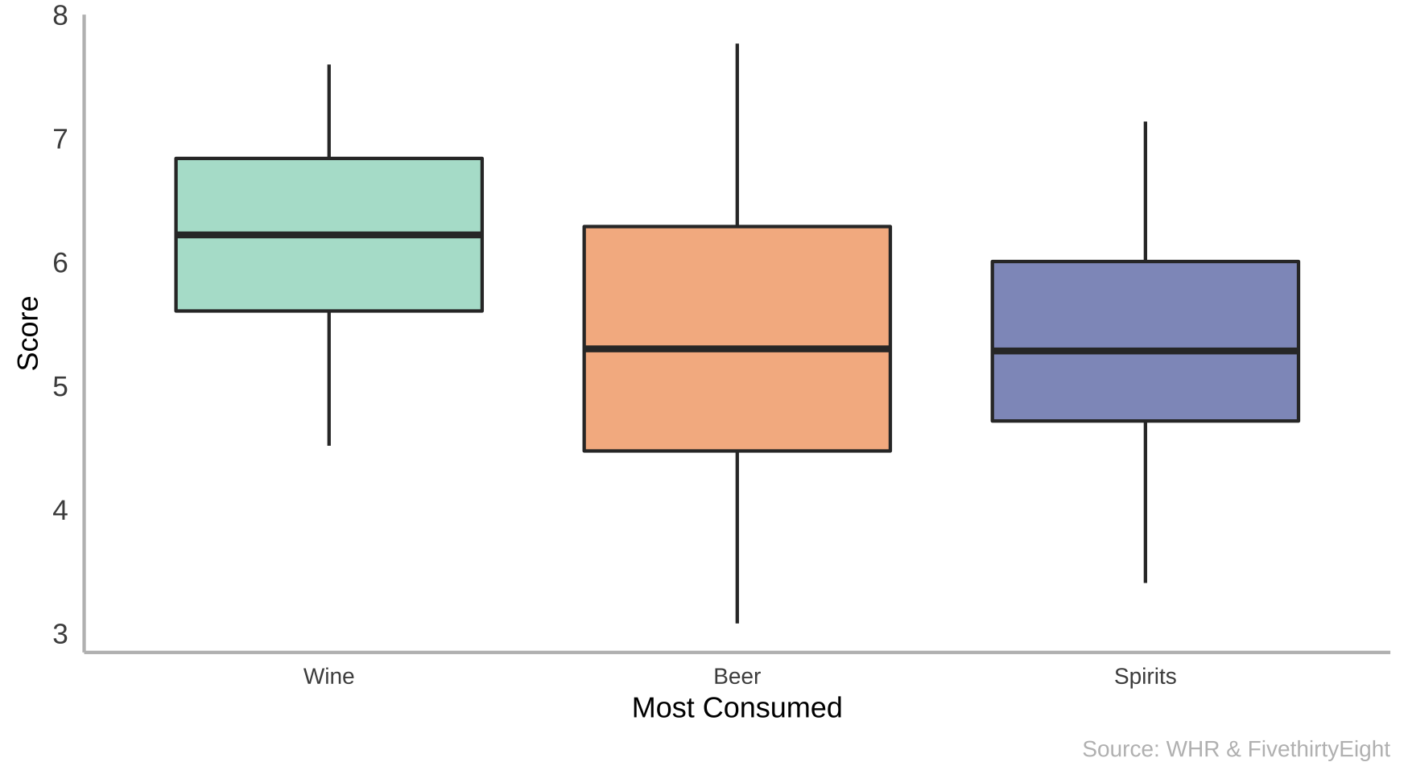
Countries that consume wine the most are the happiest
PURPOSE AND METHODOLOGY • RESULTS AND CONCLUSIONS • DISCUSSION AND CRITIQUE
Box and whisker plot of countries that consume mostly wine, beer, or spirits
Beer is the go to drink for both the happiest (Finland, Norway) and unhappiest (CAR, Tanzania) countries

Slide 15
Barriga llena, corazón contento
Colombian saying

Slide 16
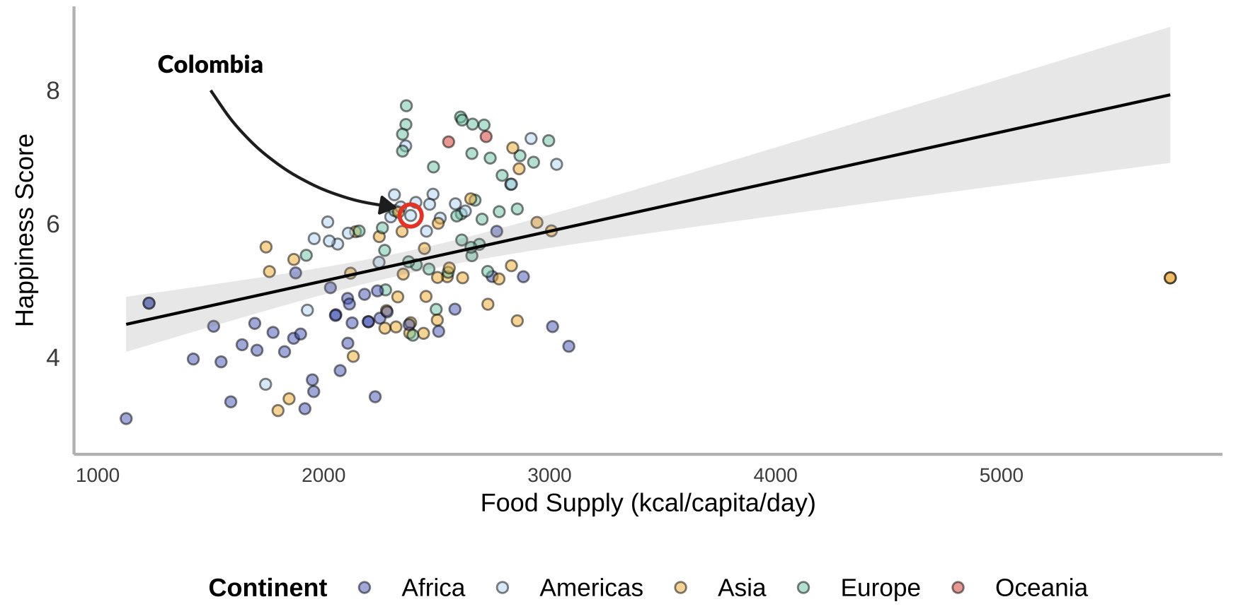
Food makes people happy
PURPOSE AND METHODOLOGY • RESULTS AND CONCLUSIONS • DISCUSSION AND CRITIQUE
Relationship between food supply (kcal/capita/day) and happiness score, by continent
Source: FAO, WHR 2019

Slide 17
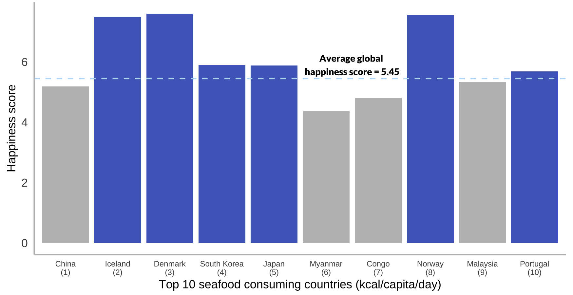
Happy as a clam?
PURPOSE AND METHODOLOGY • RESULTS AND CONCLUSIONS • DISCUSSION AND CRITIQUE
Six of the top ten seafood consuming countries have a happiness score above average.
Source: FAO, WHR 2019

Slide 18
Happy wife, happy life
Unknown - USA

Slide 19
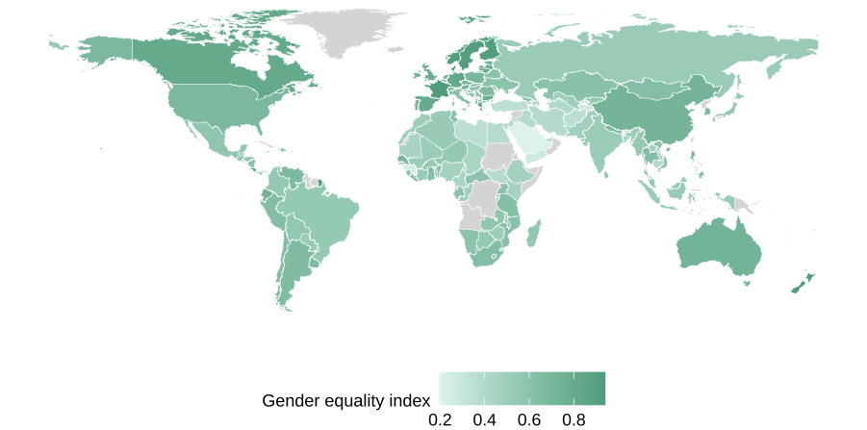
Gender equality across the world
PURPOSE AND METHODOLOGY • RESULTS AND CONCLUSIONS • DISCUSSION AND CRITIQUE
Source: World Bank

Slide 20
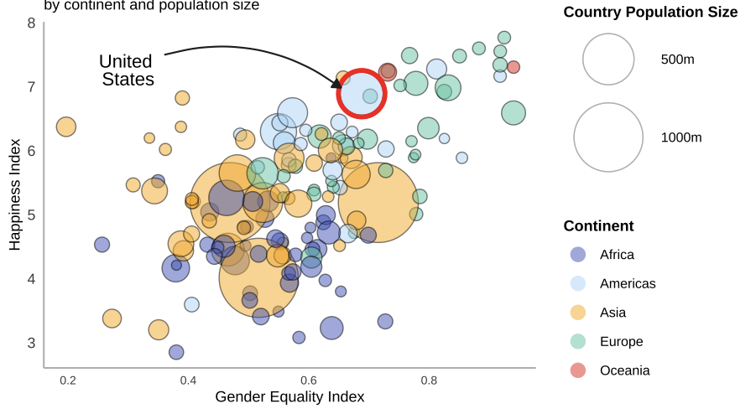
More equal countries tend to be happier
PURPOSE AND METHODOLOGY • RESULTS AND CONCLUSIONS • DISCUSSION AND CRITIQUE
Gender equality index vs. happiness score, by continent and population size
EU countries
with a small population density and high gender equality index, tend to be happier.
Source: World Bank, WHR 2019

Slide 21
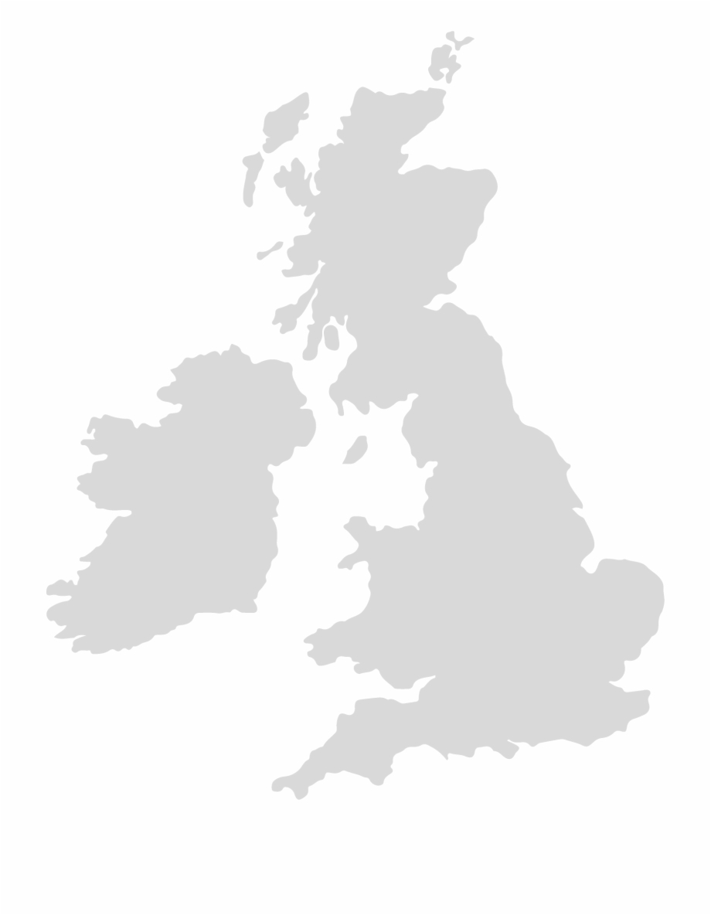
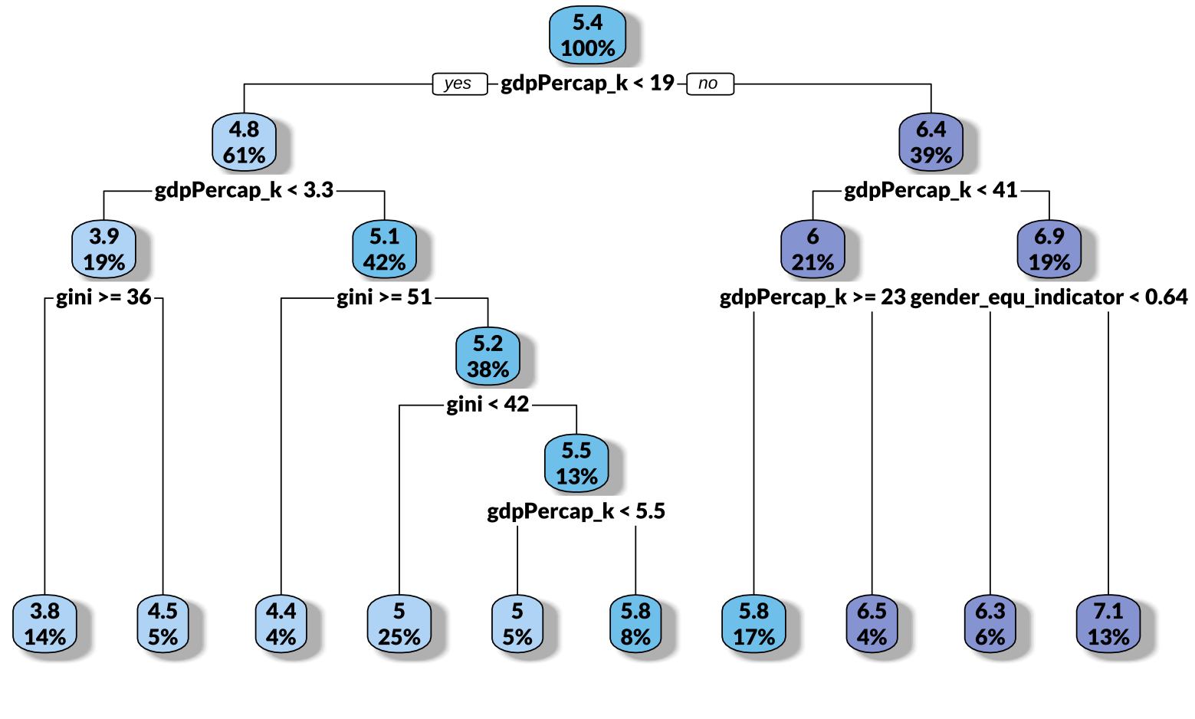
Decision Tree Model
PURPOSE AND METHODOLOGY • RESULTS AND CONCLUSIONS • DISCUSSION AND CRITIQUE
Results of the Decision Tree Model
Great Britain Indicators
GDP per Capita (k) | 48.7
Gini Index | 33.2
Gender Equality Indicator | 0.78

Slide 22
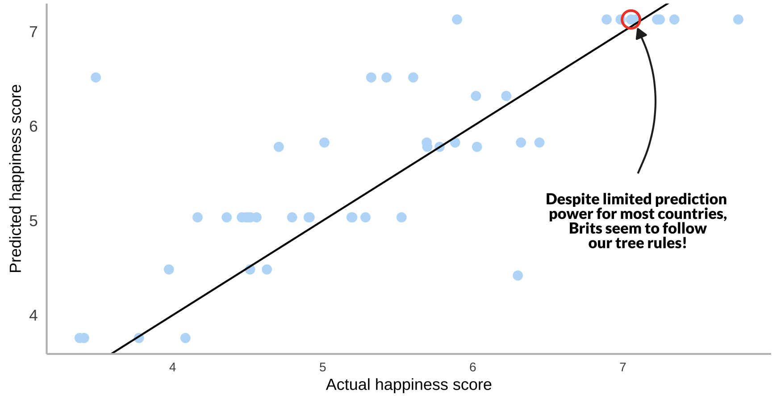
Predicting the UK’s happiness score
PURPOSE AND METHODOLOGY • RESULTS AND CONCLUSIONS • DISCUSSION AND CRITIQUE
Actual happiness diverts from our predictions, indicating poor model performance

Slide 23
Limitations and what we’ve learned
PURPOSE AND METHODOLOGY • RESULTS AND CONCLUSIONS • DISCUSSION AND CRITIQUE
While we’re happy with our results, we want to discuss some of the limitations of our work, and what we might do differently next time.
Our Datasets
Model Performance
Confounding Factors
Some of our datasets contained missing values for some countries.
The indicators chosen might not be the best proxies for the questions we’re trying to explore. For example, food supply might not be a good proxy for food consumption.
Insufficient amount of data points (~150).
Strong correlation among the explanatory variables.
Common proverbs are probably not the best starting point for prediction models :).
Difficult to determine the actual impact of these measures because they are highly correlated with other factors. Food supply and alcohol consumption, are highly correlated with wealth, for example.

Slide 24
Don’t worry, be happy!
Any questions?

